Slide 1


Notes:
Good evening. We’re SAPANA, and we’re here today to talk to you about DoD space policy.

Slide 2
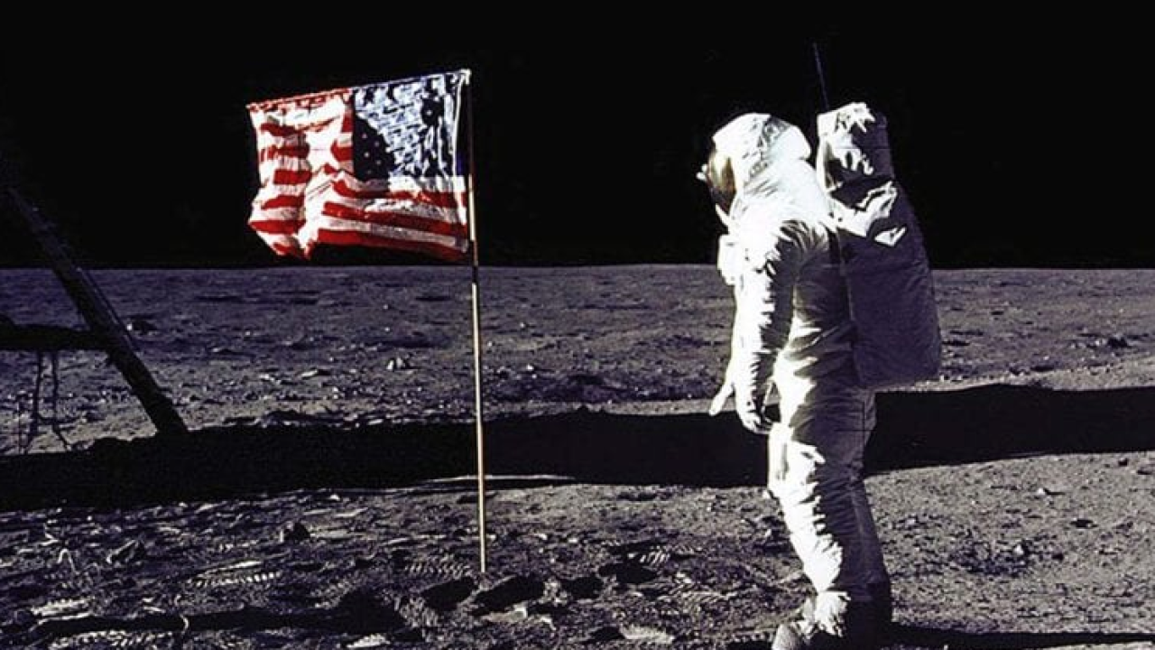
Notes:
In the previous century, the US dominated space in a way never seen before or since.

Slide 3

Notes:
People all over the world came to us for our expertise in space technologies, our launch capacity, and our willingness to trade.
But the world is changing.

Slide 4
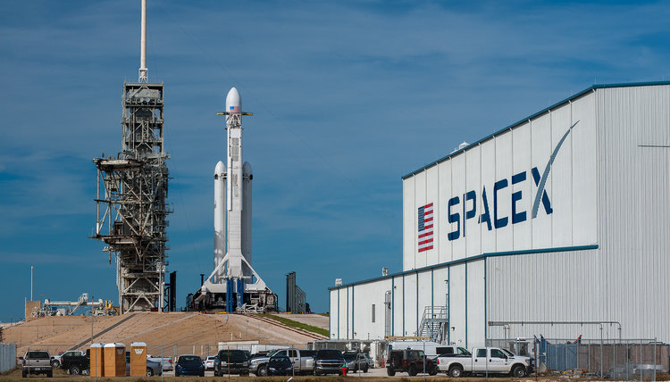
Notes:
Now commercial space is taking off globally. More countries than ever before have access to space capabilities and entrepreneurs are building constellations at unprecedented speed and scale.

Slide 5
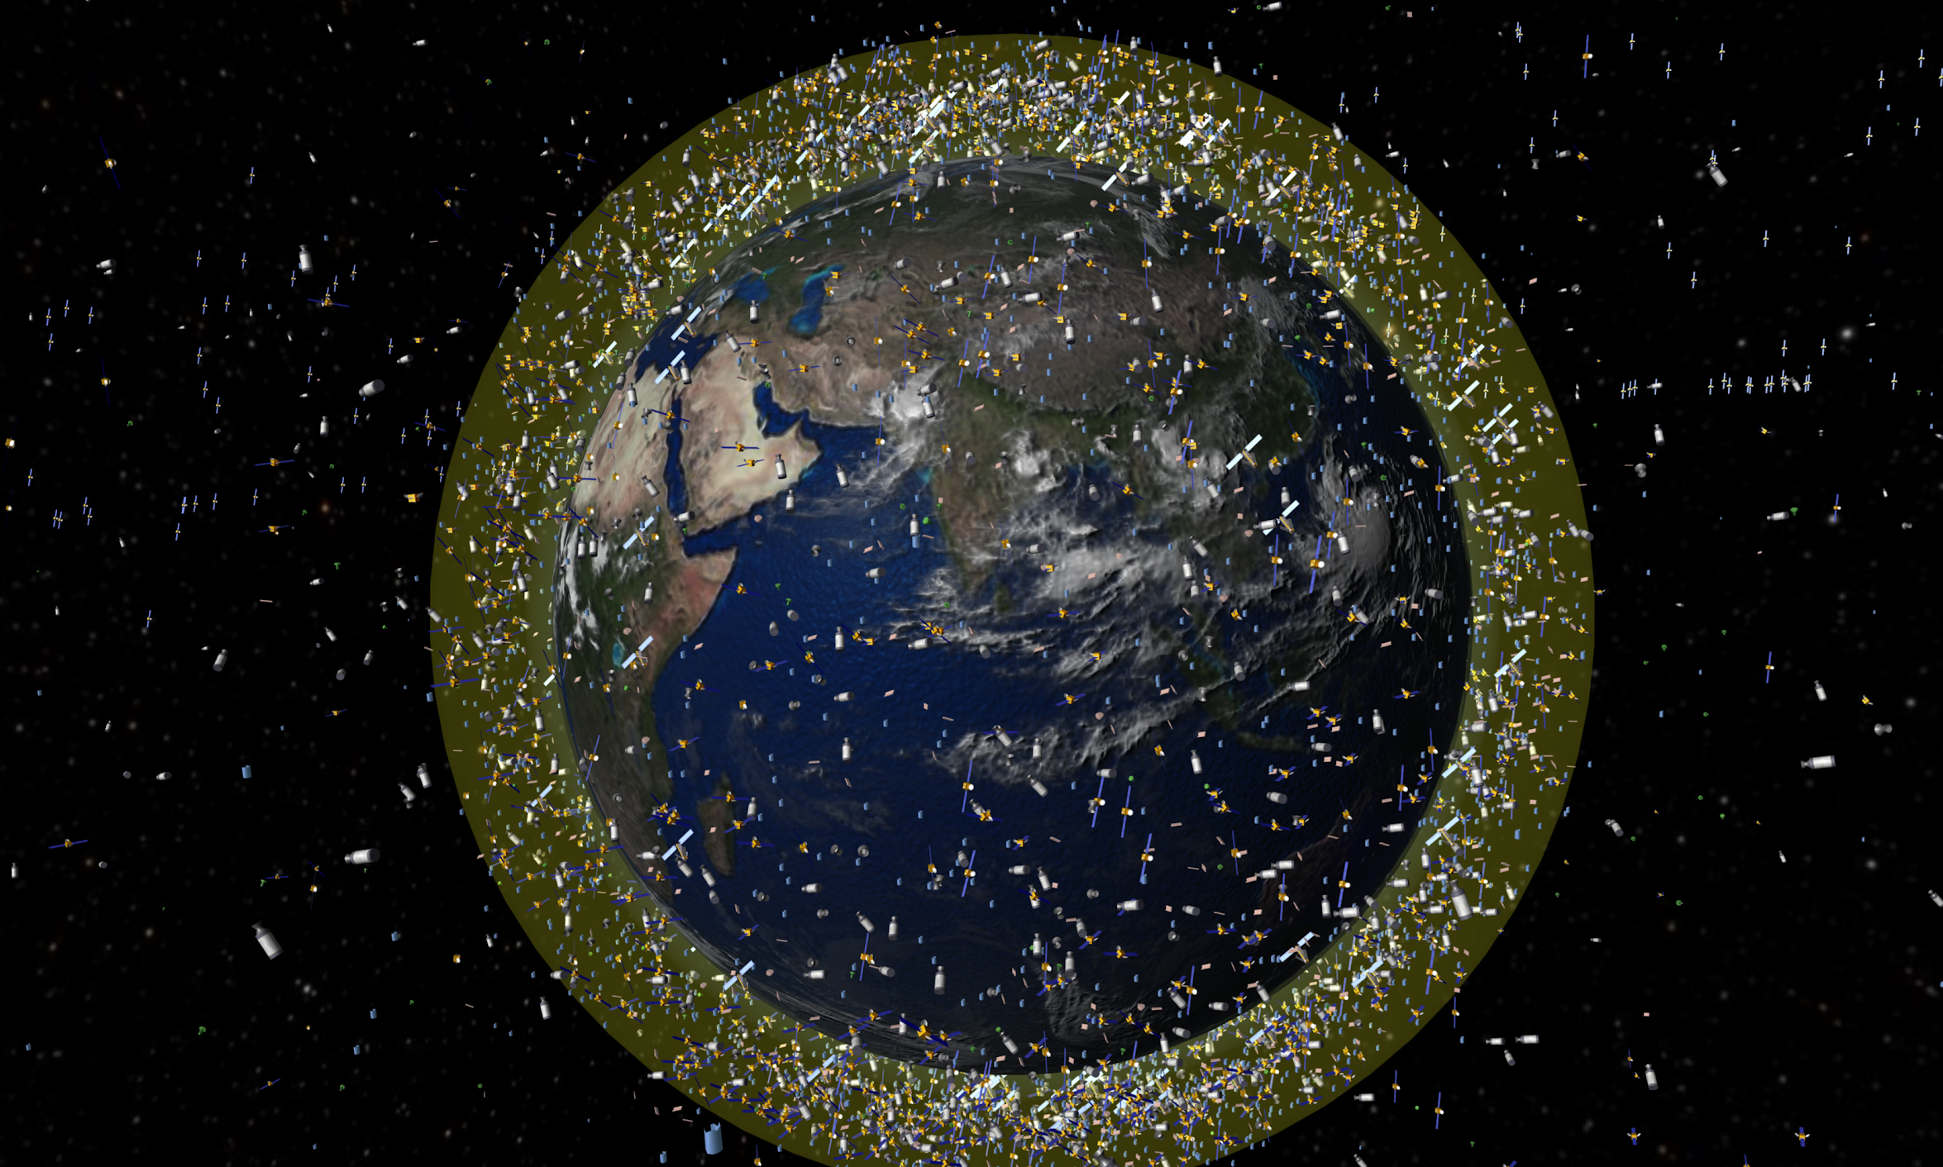
Notes:
Space, in short, is becoming democratized, privatized, and globalized, bringing new challenges for the United States.

Slide 6


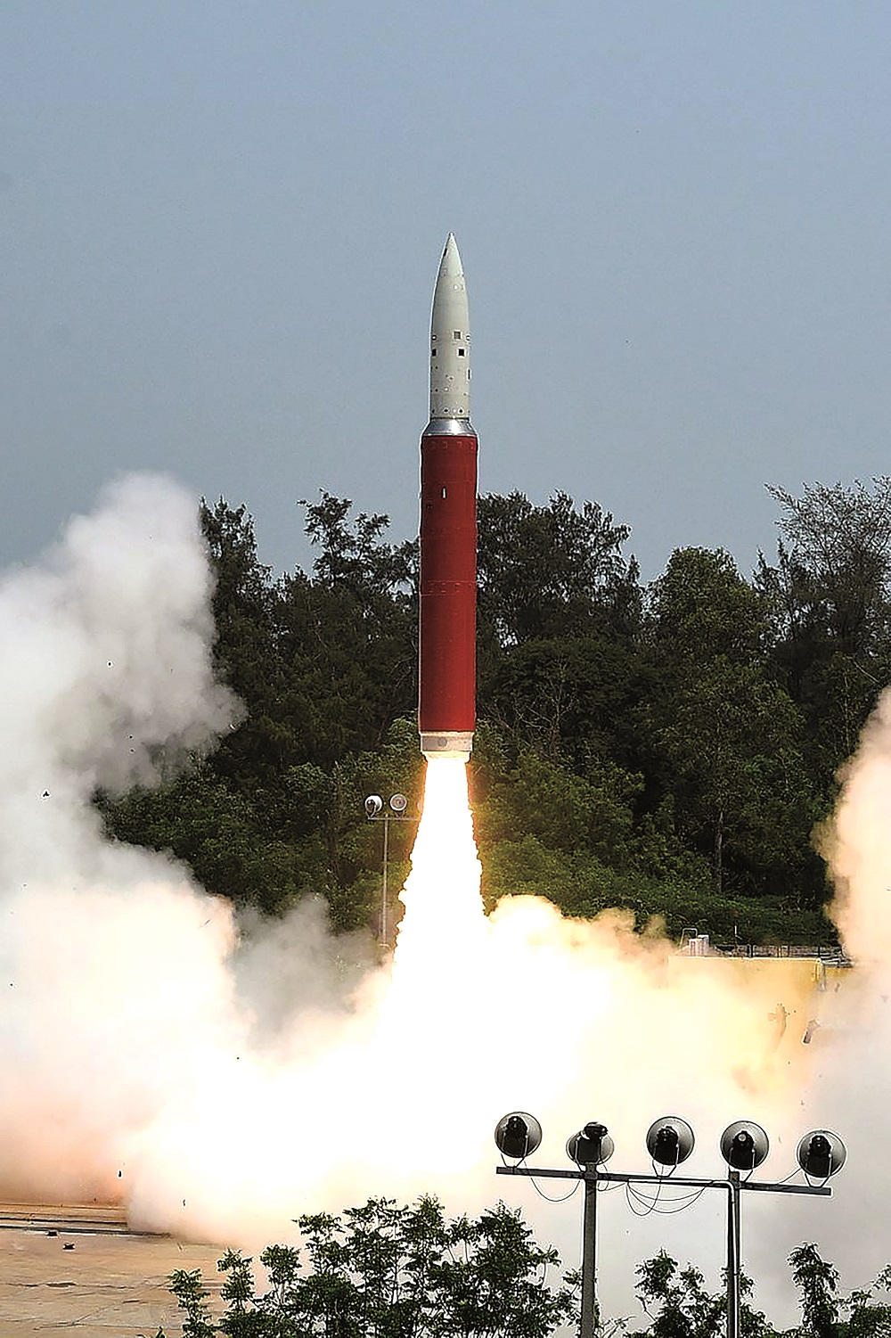
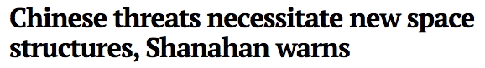


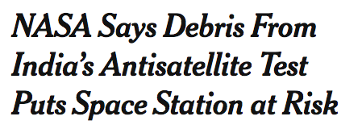
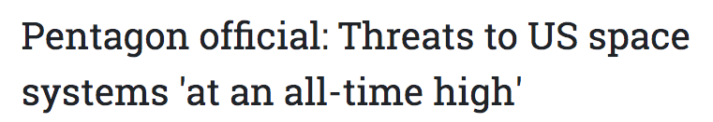
Notes:
Existing space-based systems are becoming increasingly vulnerable to deliberate attacks by rival countries or accidental collision in a congested orbit.

Slide 7
54%
US military share of satellites in orbit
31%
2005
2018
Notes:
The space technology gap between the US and the rest of the world is closing rapidly. As just one example, from 2005 to 2018, the US military’s share of orbital satellites has nearly halved.

Slide 8

Then
Now
Increasing decentralization
Notes:
And the decentralization of space is creating myriad problems of management and order in outer space. Since the US is the most dependent on space, we stand to lose more than any other country if space is not guided by a system of rules and norms

Slide 9
Challenge
Defense vulnerability
Closing technology gap
Increasing decentralization
Notes:
How the DoD addresses these problems will determine whether we lead the world into this space age, or get left behind. Any policy actions that seek to address these issues must therefore consider two questions:

Slide 10
How can the DoD leverage the growth in commercial space?
How can the DoD support US commercial space?
Notes:
First, how can the DoD leverage the growth in commercial space activity as it seeks more and better space technology in the coming years?
Second, what can the DoD do to protect and support US commercial space interests?

Slide 11



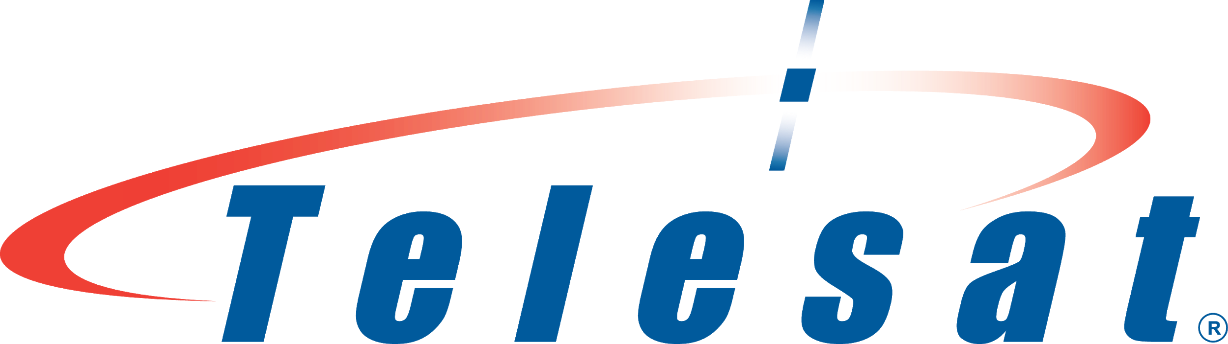

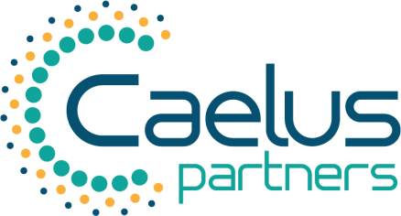









Notes:
The challenges we have identified are not new. Over the 60+ interviews we’ve conducted for this project, we’ve heard variations on these themes from industry professionals, government officials, and researchers.

Slide 12
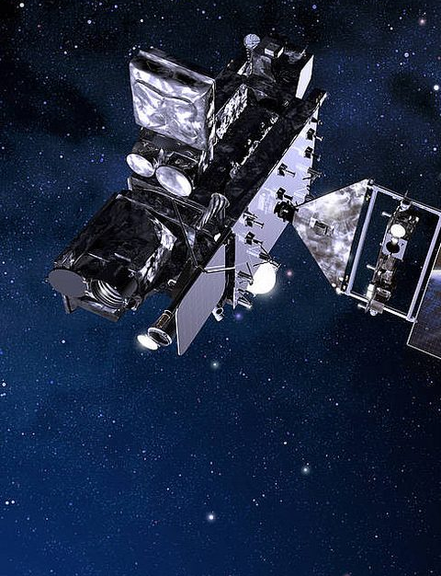

Notes:
What is new is the urgency. Whereas in the 1990s we could afford to spend time writing technical white papers about gaps in the acquisitions process, now we are faced with a stark choice.
We have the option to preserve the status quo, and enter the rapidly-changing 21st century with a comfortable, but timid, 20th century space policy framework. Or we take bold steps and make difficult decisions that will cement our place as the leaders of the 21st century space domain.
Let’s talk about what such a policy might look like.

Slide 13



Maximal Value
Robust Industry
Global Integration
Notes:
Any 21st century DoD space policy framework should achieve three goals: [1] deliver the best possible product to the DoD at lowest cost and on time to meet emerging defense needs, [2] improve the health and robustness of the US commercial space industry, and [3] lay the groundwork for a system of space governance that strengthens the US’ position politically and economically.

Slide 14

Civil Reserve Space Fleet
Risk Tolerance
Public-Private Partnerships
Trade Liberalization
Contract Management Office
Clearance Clearinghouses
Notes:
Today we want to briefly introduce to you two specific policy approaches which support these goals, part of a broader portfolio of policies we’ve assembled for the DoD. We believe these two have the biggest potential for transformative impact.

Slide 15

Civil Reserve Space Fleet
Notes:
First, quick access to launch and satellite capabilities is essential to preserve defense readiness. We propose the establishment of a Civil Reserve Space Fleet.

Slide 16
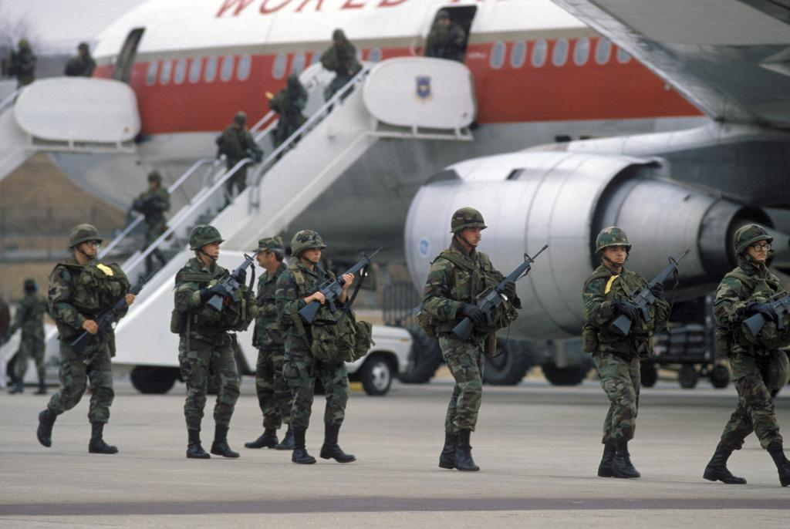
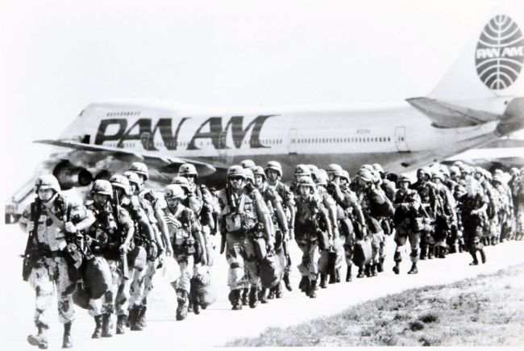
Notes:
This is modeled on the Civil Reserve Air Fleet, a program wherein the DoD can use commercial airline capacity for airlift and other contingency needs. Rather than continually managing large fleets for irregular demands, the DoD takes advantage of commercial capacity as needed. The Merchant Marine Fleet is another example. These programs reduce the DoD’s operational costs of maintaining capacity in normal times, and can be invaluable during crises.

Slide 17
What
Commercial capacity
Defense flexibility
How
Executive Authorization
Managed by SMC
Notes:
A similar program for space would reduce costs, increase operational agility, and encourage the development of new business models for space technologies. And while the DoD may provide baseline demand for these products, the companies are able to generate the majority of their revenues in other markets, encouraging sustainable business models.
Here’s what we recommend OSD does to get the ball rolling. Set up a pilot CRSF program for LEO smallsat launches under SMC. Once the program has been worked out for smallsat launches, OSD can draw up plans to expand into other space services such as bandwidth, imaging, and on-orbit servicing. Eventually Congress will need to be involved to approve additional funds.

Slide 18
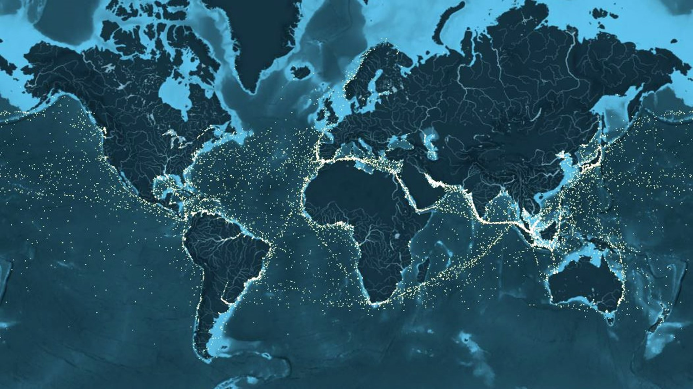
Notes:
But it’s not enough to feed the US commercial space sector on US demand. We have bigger appetites.
Currently, excessive restrictions on exports and imports of space technology are crippling innovative American companies trying to compete internationally, and limiting the DoD’s ability to harness the full range of space technologies and business models available.

Slide 19

Trade Liberalization
What
American companies
Global markets
Notes:
Opening up to trade can fix this.
Additionally, trading with our competitors increases their dependence on our technology and reduces their payoff from attacking our infrastructure.

Slide 20

Notes:
We’ve seen the opposite story before. In 1999, Congress passed export controls to limit the Chinese space industry. And for a few years it worked. But eventually, others stepped in to fill the void we left. Chinese launch activity picked up again. And our satellite industry paid the price.

Slide 21
How
Continue to accelerate export licensing
Shorter cycles to move items from USML to CCL
Notes:
Additionally, trading with our competitors increases their dependence on our technology and reduces their payoff from attacking our infrastructure.
We’ve seen the opposite story before. In 1999, Congress passed export controls to limit the Chinese space industry. And for a few years it worked. But eventually, others stepped in to fill the void we left. Chinese launch activity picked up again. And our satellite industry paid the price.
Here’s what we recommend OSD do. Start by working with SMC and SDA to develop a definition of "state of the world" technologies, then work on establishing a process to automate moving such technologies from USML to CCL.
To be most effective this will need to be paired with international IP reform.

Slide 22







Tim Passmore, PhD
Akhil Rao, PhD
Daniel Scott
Britnee Leopold
Strategy
Policy
Operations
Public Relations
Political Science
Economics
Computer Science
Aerospace Engineering
Matt Roberts
Kimberly DeVore
Meer Baker
Research
Product Development
Product Development
Mechanical Engineering
Mechanical Engineering
Aerospace Engineering
Notes:
But why listen to us?
We have a unique combination of experience spanning from policy and economic expertise to technical expertise in aerospace and mechanical engineering.
In the last 3 months we’ve interviewed leading government and industry figures, representing over 1000 collective years of space experience, military and commercial.
We bring a fresh, but educated, perspective to this field.

Slide 23

Visit us at: SAPANA.space
Notes:
To wrap it up: changing times require changing strategies. The status quo for DoD-commercial space relations is no longer fit to purpose. To cement American dominance and security in the 21st century, we need a new defense space policy framework, one which can view space as a service (SpaaS) and makes it easier for US companies to trade space technologies abroad beyond the Five Eyes community.
The steps we have articulated may be uncomfortable, but we are the USA. Timidity is not who we are. We must choose to stride boldly forward, for ourselves and our future. Thank you.

